Slide 1
CORE TRAINING
January 2025

Slide 2

Core Training
PEOPLE CLOSEST TO YOU
Getting Started and Mindset for Success
The Compensation Plan
Customer Acquisition
Team Building
Promoting Training Events

Slide 3

Getting Started &
Mindset for Success

Slide 4

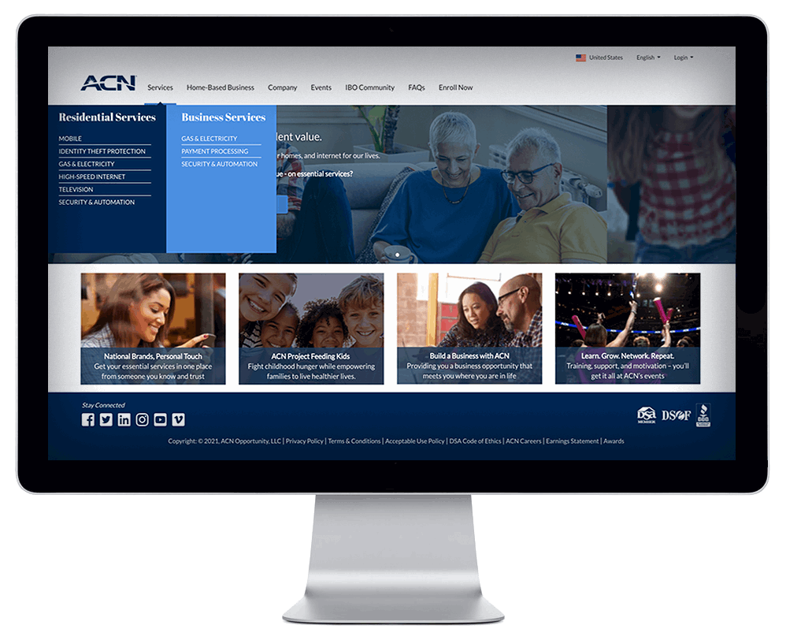
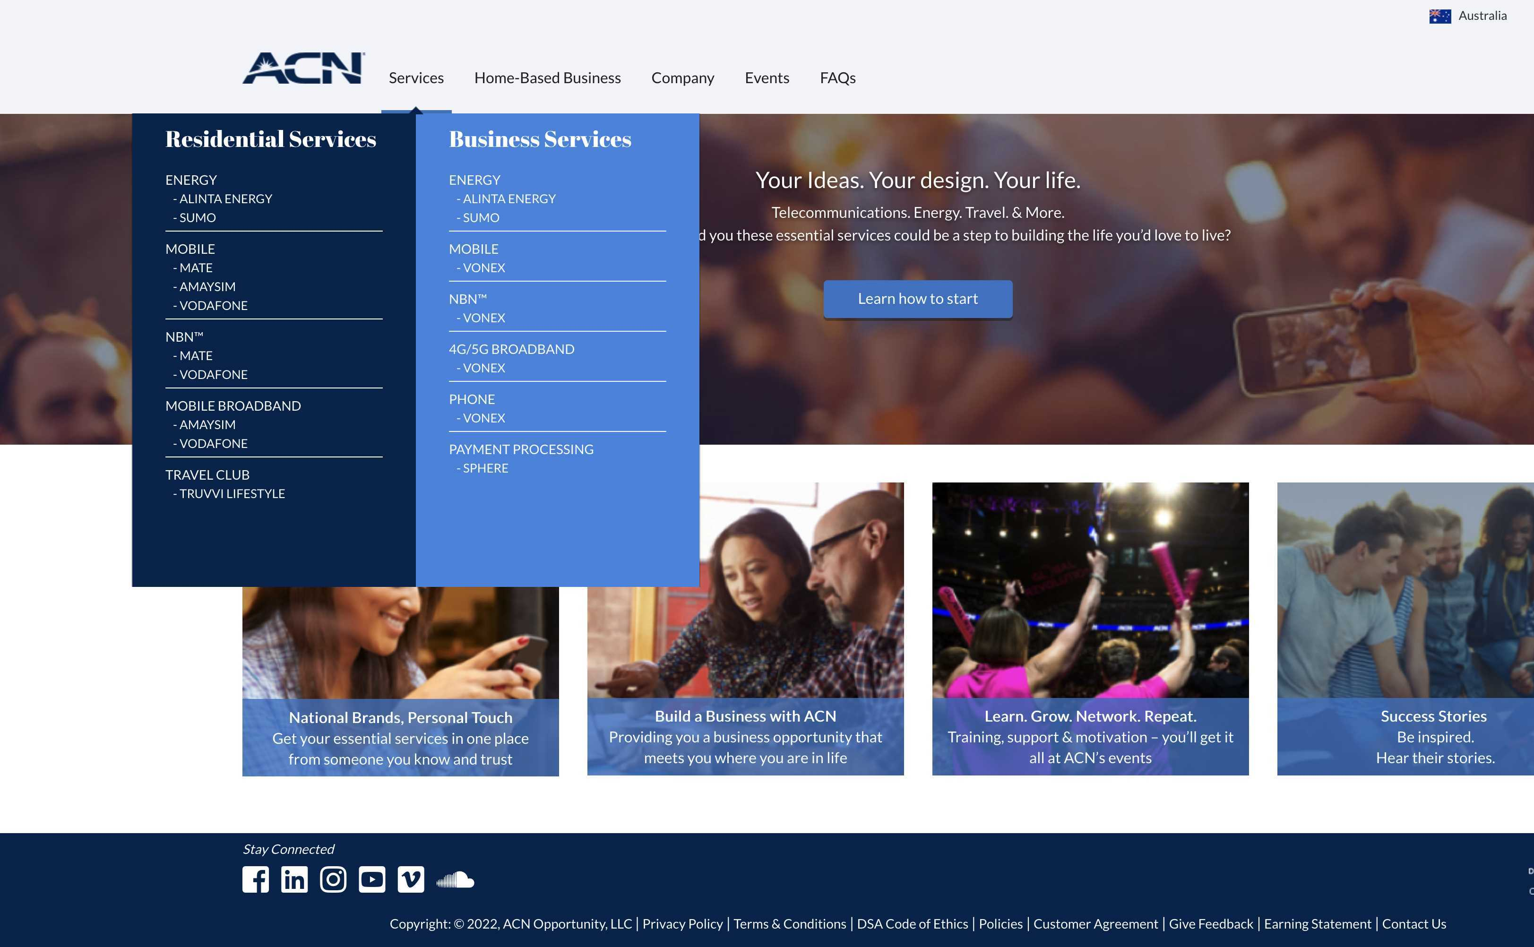
Getting Started
Download Your Launch List
Set up Your Conxxion Personalised Storefront / Website
  Designed for Acquiring
  Customers & Building a Team
  Log in to your IBO Back Office &
  select “Update Information”
Complete Your Accreditations
YOUR PERSONAL WEBSITE
UPDATE INFORMATION

Slide 5

Mindset for Success!
Develop the Right Mental Attitude
Determine your “WHY”
Make a Decision
Learning Curve
Emotional Roller Coaster
Be Coachable
Have Long Term Thinking
Keep it SIMPLE

Slide 6

Getting Started/Mindset
KISS: Keep It Super Simple
We do TWO things:
  Get Customers
  Get Customer Getters

Slide 7
Conxxion Core Values
1
2
3
HONESTY
INTEGRITY
CREDIBILITY
Company
Protecting the integrity of the Conxxion Business Opportunity and the rights of Independent Business Owners and the customer
Honesty, integrity, and credibility underpin everything we do at Conxxion and why your understanding and application of Conxxion's core values matter.
Your Responsibilities
Represent and pursue the Conxxion Opportunity in an ethical and professional manner
Provide customers with truthful and accurate information regarding Conxxion's products and services.

Slide 8

Make your Contact List
Warm Market (People you know)
PEOPLE CLOSEST TO YOU
Friends
Family
Social Media
Work Associates
Place of Worship
School
Places Where you do Business
Sports/Clubs/Associations
Business Owners

Slide 9
Make your Contact List
Warm Market (People you know)
Do not pre-judge
The truth is...
Those you think will, won't
Those you think won't, will
Those you think can, can't
Those you think can't, can

Slide 10
New IBO - Considerations
Has the prospect been involved in Conxxion before?
Is the prospect’s spouse/de facto already an IBO?
X

Slide 11



We ARE in the SORTING Business
NOT in the SELLING Business!
Red
Apples
Green Apples
Brown Apples
YES
MAYBE
Questions
NO
80% of your time
20% of your time
0% of your time
People typically fall into one of three categories
Your contact's response is all about timing!

Slide 12
SW / SW / SW / SW
NEXT
Some Will / Some Wait / Some Won’t
SO WHAT!

Slide 13

Mastering the Conxxion
Compensation Plan

Slide 14
Learn it
IT WILL MOTIVATE YOU
It will show you where to focus your efforts

Slide 15


Compensation Plan
Paid Weekly as earned
Customer Bonuses
Personal Monthly Customer Bonuses
Team Customer Acquisition Bonuses (CABs)
Paid Monthly
Residual Income
Personal Residual Income
Team Residual Income
Refer to Compensation Plan for terms and conditions and complete details.

Slide 16
Compensation Plan – Earned Positions
CQ
ETL
RC
RD
RVP
SVP
IBO
Independent
Business
Owner
Customer Qualified
Executive Team Leader
Regional Coordinator
Regional Director
Regional Vice President
Senior Vice President
Follow the Plan
Think of this as your “Road Map” or “Business Plan”
The higher of an EARNED POSITION you achieve…
Your Business is Growing
You Get Paid More & Better

Slide 17





Compensation Plan – Points System
SERVICES - Range from 1 - 4 Points or more
CUSTOMERS - Can use multiple services
RESIDENTIAL
Energy
Mobile
NBN
Broadband
Home Insurance
4
Example:
POINTS
Electricity & Gas
5
POINTS
Home Insurance
BUSINESS
Energy
Mobile
NBN
4G/5G Broadband
VoIP
Phone
Payment Processing
1 Customer
2
5 Services
14 Points
POINTS
Broadband
3
POINTS
Mobile
Refer to Compensation Plan for terms and conditions and complete details.

Slide 18
Compensation Plan – Personal Residual Income
CQ
ETL
RC
RD
RVP
SVP
IBO
You 3%-20%
You can earn up to 20% Residual Income on all the “Commissionable Revenue” generated by YOUR
PERSONAL CUSTOMERS
Refer to Compensation Plan for terms and conditions and complete details.

Slide 19
Compensation Plan – Personal Residual Income
CQ
ETL
RC
RD
RVP
SVP
IBO
You 3%-20%
1 - 39 Personal Customer Points = 3%
40 - 59 Personal Customer Points = 5%
60 - 99 Personal Customer Points = 10%
100 - 149 Personal Customer Points = 14%
150 - 199 Personal Customer Points = 17%
200 + Personal Customer Points = 20%
Each increase in commissions applies to BOTH your
NEW & EXISTING Customers Commissionable Revenue
Refer to Compensation Plan for terms and conditions and complete details.

Slide 20
Compensation Plan – Team Residual Income
CQ
ETL
RC
RD
RVP
SVP
IBO
You 3%-20%
You can earn 3%
Team Residual Income
through 5 Levels on all the “Commissionable Revenue”
generated by your
TEAM’s CUSTOMERS
1) 3%
2) 3%
3) 3%
4) 3%
5) 3%
Refer to Compensation Plan for terms and conditions and complete details.

Slide 21

Compensation Plan – Team Residual Income
CQ
ETL
RC
RD
RVP
SVP
IBO
You 3%-20%
1) 3%
2) 3%
3) 3%
4) 3%
5) 3%
What is a LEVEL?
Refer to Compensation Plan for terms and conditions and complete details.

Slide 22
Compensation Plan – Team Residual Income
CQ
ETL
RC
RD
RVP
SVP
IBO
You 3%-20%
The GOAL, BENEFIT & INTENT of
5 Levels & Team Residual Commissions is:
Exponential Growth
Definition:
Growth whose rate becomes ever more rapid in proportion to the growing total number or size
1) 3%
2) 3%
3) 3%
4) 3%
5) 3%
Refer to Compensation Plan for terms and conditions and complete details.

Slide 23
Compensation Plan – Team Residual Income
CQ
ETL
RC
RD
RVP
SVP
IBO
You 3%-20%
Total 364 IBOs
1) 3%
3 IBOs
Exponential Growth
Example
2) 3%
9 IBOs
3) 3%
27 IBOs
4) 3%
81 IBOs
5) 3%
243 IBOs
Refer to Compensation Plan for terms and conditions and complete details.

Slide 24
Compensation Plan – Team Residual Income
CQ
ETL
RC
RD
RVP
SVP
IBO
You 3%-20%
Total 364 IBOs
1) 3%
3 IBOs
Customers
Customers
Customers
Customers
Customers
Customers
Customers
2) 3%
9 IBOs
3) 3%
27 IBOs
4) 3%
81 IBOs
5) 3%
243 IBOs
Refer to Compensation Plan for terms and conditions and complete details.

Slide 25
Compensation Plan – Team Residual Income
CQ
ETL
RC
RD
RVP
SVP
IBO
Customers totalling
Services
You 3%-20%
20
1) 3%
3 IBOs
2
18
8
28 Services
2) 3%
5 IBOs
19
1
6
15
7
48 Services
3) 3%
6 IBOs
10
19
8
12
3
15
67 Services
94 Services
4) 3%
17
10
15
9
7
14
10
4
8
9 IBOs
11 IBOs
5) 3%
5
16
12
18
10
14
9
6
17
10
11
128 Services
Total: IBOs 35 Services: 385
Refer to Compensation Plan for terms and conditions and complete details.

Slide 26
Compensation Plan – Team Residual Income
CQ
ETL
RC
RD
RVP
SVP
IBO
You 3%-20%
QUESTION:
How much can you earn in monthly residual income?
1) 3%
2) 3%
ANSWER…
It's based on the total Commissionable Revenue generated by all the Customers X the Commission %
3) 3%
4) 3%
The more customers acquired; the more revenue generated, the more you can earn
5) 3%
Refer to Compensation Plan for terms and conditions and complete details.

Slide 27

Compensation Plan – Team Residual Income
CQ
ETL
RC
RD
RVP
SVP
IBO
You 3%-20%
Earn 3% on the customers acquired by IBOs through
5 levels
1) 3%
40 Personal Customer Points
2) 3%
40 Personal Customer Points
There is a requirement to acquire & maintain a certain number of Personal Customer Points
3) 3%
60 Personal Customer Points
4) 3%
75 Personal Customer Points
5) 3%
75 Personal Customer Points
See Compensation Plan for full details

Slide 28
Compensation Plan – Earned Positions
CQ
ETL
RC
RD
RVP
SVP
IBO
7
Personal Customer Points
(3 Services)
30
Total Customer Points
200
Total Customer Points
600
Total Customer Points
RVP & SVP
See Conxxion Compensation Plan Document for Details
You 3%-20%
1) 3%
2) 3%
3) 3%
4) 3%
5) 3%
Refer to Compensation Plan for terms and conditions and complete details.

Slide 29
Compensation Plan – Earned Positions
CQ
ETL
RC
RD
RVP
SVP
IBO
7
Personal Customer Points
(3 Services)
30
Total Customer Points
200
Total Customer Points
600
Total Customer Points
RVP & SVP
See Conxxion Compensation Plan Document for Details
You 3%-20%
1) 3%
CQs must maintain a minimum of 7 Points &
3 Services (Personal).
2) 3%
3) 3%
4) 3%
5) 3%
Refer to Compensation Plan for terms and conditions and complete details.

Slide 30
Compensation Plan – Earned Positions
CQ
ETL
RC
RD
RVP
SVP
IBO
7
Personal Customer Points
(3 Services)
30
Total Customer Points
200
Total Customer Points
600
Total Customer Points
RVP & SVP
See Conxxion Compensation Plan Document for Details
You 3%-20%
1) 3%
CQs must maintain a minimum of 7 Points &
3 Services (Personal).
ETLs must maintain CQ & a minimum of 30 Points in your Team (Personal and Downline).
A minimum of 15 Downline Customer Points.
2) 3%
3) 3%
4) 3%
5) 3%
Refer to Compensation Plan for terms and conditions and complete details.

Slide 31
Compensation Plan – Earned Positions
CQ
ETL
RC
RD
RVP
SVP
IBO
7
Personal Customer Points
(3 Services)
30
Total Customer Points
200
Total Customer Points
600
Total Customer Points
RVP & SVP
See Conxxion Compensation Plan Document for Details
You 3%-20%
1) 3%
CQs must maintain a minimum of 7 Points &
3 Services (Personal).
ETLs must maintain CQ & a minimum of 30 Points in your Team (Personal and Downline).
A minimum of 15 Downline Customer Points.
RCs must maintain CQ & a minimum of 200 Points in your Team (Personal and Downline) with a maximum of 75 Customer Points per leg.
2) 3%
3) 3%
4) 3%
5) 3%
Refer to Compensation Plan for terms and conditions and complete details.

Slide 32
Compensation Plan – Earned Positions
CQ
ETL
RC
RD
RVP
SVP
IBO
7
Personal Customer Points
(3 Services)
30
Total Customer Points
200
Total Customer Points
600
Total Customer Points
RVP & SVP
See Conxxion Compensation Plan Document for Details
You 3%-20%
1) 3%
CQs must maintain a minimum of 7 Points &
3 Services (Personal).
ETLs must maintain CQ & a minimum of 30 Points in your Team (Personal and Downline).
A minimum of 15 Downline Customer Points.
RCs must maintain CQ & a minimum of 200 Points in your Team (Personal and Downline) with a maximum of 75 Customer Points per leg.
RDs must maintain CQ & a minimum of 600 Points in your Team (Personal and Downline) with a maximum of 200 Customer Points per leg.
2) 3%
3) 3%
4) 3%
5) 3%
Refer to Compensation Plan for terms and conditions and complete details.

Slide 33
Compensation Plan – Personal Customer Bonuses
CQ
ETL
RC
RD
RVP
SVP
IBO
3 Services
7 Points
You 3%-20%
CQ
1) 3%
You
$75
Customers Acquired within 1st 30 days
Personal
Customer Bonuses
2) 3%
Acquire Customers Totaling:
3 Services 6 Points Earn $75 (Existing IBOs Only)
6 Services 12 Points Earn $150
3) 3%
9 Services 18 Points Earn $225
PLUS, for Every Additional
3 Services 6 Points Earn $75
4) 3%
12 Services 24 Points Earn $300
15 Services 30 Points Earn $375
5) 3%
EXISTING IBOs
Customers Acquired within calendar month
Refer to Compensation Plan for terms and conditions and complete details.

Slide 34
Compensation Plan – Customer Acquisition Bonuses CABs
CQ
ETL
RC
RD
RVP
SVP
IBO
3 Services
7 Points
You 3%-20%
ETL & Higher can EARN
TEAM Customer Acquisition Bonuses CABs
CQ
1) 3%
You
$75
2) 3%
CABs are paid weekly as earned when NEW IBOs on your team acquire Customers and become CQ within their 1st 30 days
3) 3%
4) 3%
5) 3%
Refer to Compensation Plan for terms and conditions and complete details.

Slide 35
Compensation Plan – Customer Acquisition Bonuses CABs
CQ
ETL
RC
RD
RVP
SVP
IBO
3 Services
7 Points
You 3%-20%
CQ
1) 3%
You
$75
CQ
2) 3%
IBO
$0
3) 3%
4) 3%
5) 3%
Refer to Compensation Plan for terms and conditions and complete details.

Slide 36
Compensation Plan – Customer Acquisition Bonuses CABs
CQ
ETL
RC
RD
RVP
SVP
IBO
3 Services
7 Points
30 Personal & Team Customer Points
You 3%-20%
CQ
1) 3%
You
$75
CQ
CQ
2) 3%
IBO
$0
IBO
$50
1st Gen
3) 3%
ETL $0
4) 3%
5) 3%
Refer to Compensation Plan for terms and conditions and complete details.

Slide 37
Compensation Plan – Customer Acquisition Bonuses CABs
CQ
ETL
RC
RD
RVP
SVP
IBO
3 Services
7 Points
30 Personal & Team Customer Points
200 Personal & Team Customer Points
You 3%-20%
CQ
1) 3%
You
$75
CQ
CQ
CQ
2) 3%
IBO
$0
IBO
$50
IBO
$100
1st Gen
ETL $50
3) 3%
ETL $0
4) 3%
1st Gen
RC $25
5) 3%
Refer to Compensation Plan for terms and conditions and complete details.

Slide 38
Compensation Plan – Customer Acquisition Bonuses CABs
CQ
ETL
RC
RD
RVP
SVP
IBO
3 Services
7 Points
30 Personal & Team Customer Points
200 Personal & Team Customer Points
600 Personal & Team Customer Points
You 3%-20%
CQ
1) 3%
You
$75
CQ
CQ
CQ
CQ
2) 3%
IBO
$0
IBO
$50
IBO
$100
IBO
$250
1st Gen
ETL $50
ETL $200
3) 3%
ETL $0
4) 3%
1st Gen
RC $25
RC $175
5) 3%
1st Gen
RD $75
Refer to Compensation Plan for terms and conditions and complete details.

Slide 39
Compensation Plan – Customer Acquisition Bonuses CABs
CQ
ETL
RC
RD
RVP
SVP
IBO
3 Services
7 Points
30 Personal & Team Customer Points
200 Personal & Team Customer Points
600 Personal & Team Customer Points
RVP & SVP
You 3%-20%
Increased CAB Bonuses
Incentive Trips
Increased Residual Income
RVP up to 3% below 5 levels,
SVP up to 2% below 5 levels!
CQ
1) 3%
You
$75
CQ
CQ
CQ
CQ
2) 3%
IBO
$0
IBO
$50
IBO
$100
IBO
$250
1st Gen
ETL $50
ETL $200
3) 3%
ETL $0
4) 3%
1st Gen
RC $25
RC $175
5) 3%
1st Gen
RD $75
Refer to Compensation Plan for terms and conditions and complete details.

Slide 40

Compensation Plan
Paid Weekly as earned
Customer Bonuses
Personal Monthly Customer Bonuses
Team Customer Acquisition Bonuses (CABs)
Paid Monthly
Residual Income
Personal Residual Income
Team Residual Income
Refer to Compensation Plan for terms and conditions and complete details.

Slide 41
NEW IBO FAST START BONUSES
New IBOs with a start date in January, can earn even more in their first year at Conxxion by achieving the following Fast Start Bonuses:
CQ in 30 Days
New IBOs who achieve Customer Qualified in their first 30 days.
ETL in 30 Days
1 CQ in their 30 days + $200
2 CQs in their 30 days + $200
3 CQs in their 30 days + $300
RC in 90 Days
New IBOs who achieve Regional Coordinator in their first 90 days and maintain the position for 60 days.
(50% paid immediately)
RD in 180 Days
New IBOs who achieve Regional Director in their first 180 days and maintain the position for 90 days.
(50% paid immediately)
RVP in 12 Months
New IBOs who achieve Regional Vice President in their first 12 months and maintain the position for 90 days.
$75
$700
$1,000
$5,000
$20,000
TOTAL: $26,775
These bonuses are in addition to the Monthly Personal Customer Bonuses!
Refer to Compensation Plan and Promotional Bonuses for complete details.

Slide 42



Super January Bonus
NEW IBO
New IBOs with a start date in January, that achieve the position of Reginal Director in 120 days will earn a Super January Bonus:
in 120 Days
New IBOs who achieve Regional Director in their first 120 days and maintain the position for 90 days.
(50% paid immediately)
in 180 Days
New IBOs who achieve Regional Director in their first 180 days and maintain the position for 90 days.
(50% paid immediately)
TOTAL RD BONUS
$7,500
The RD in 120 day bonus is in addition to the RD in
180 day Bonus!
+
=
$2,500
$5,000
Refer to Compensation Plan and Promotional Bonuses for complete details.

Slide 43
Achieve ETL in 30 Days on Your Own
New IBOs with a start date in January, can earn even more by achieving
ETL in 30 Days and sponsoring up to 3 new IBOs that achieve CQ in their 30 days
and a Monthly Personal Customer Bonus:
FIRST 30 DAY FAST START BONUSES
MONTHLY CUSTOMER BONUSES
BONUS POTENTIAL
Up to
CQ in 30 Days
12
Points
$150
$225
6
Services
+
+
=
18
Points
$75
$225
$300
9
Services
24
Points
$300
$375
12
Services
Refer to Compensation Plan and Promotional Bonuses for complete details.

Slide 44
Achieve ETL in 30 Days With a Team
New IBOs with a start date in January, can earn even more by achieving
ETL in 30 Days and sponsoring up to 3 new IBOs that achieve CQ in their 30 days
and a Monthly Personal Customer Bonus:
FIRST 30 DAY FAST START BONUSES
MONTHLY CUSTOMER BONUSES
BONUS POTENTIAL
Up to
CQ in 30 Days
ETL in 30 Days
12
Points
$150
$925
6
Services
+
+
=
Up to
$700
18
Points
$75
$225
$1,000
9
Services
24
Points
1 CQ in their 30 days + $200
2 CQs in their 30 days + $200
3 CQs in their 30 days + $300
$300
$1,075
12
Services
Refer to Compensation Plan and Promotional Bonuses for complete details.

Slide 45


ETL in 30 Days
1 CQ in their 30 days + $200
2 CQs in their 30 days + $200
3 CQs in their 30 days + $300
IN YOUR FIRST 30 DAYS
IN THEIR FIRST 30 DAYS
BONUS
Achieve CQ
Achieve ETL
Sponsor a new IBO
Achieve CQ
+ $200
= $200
Sponsor a 2nd IBO
Achieve CQ
+ $200
= $400
Sponsor a 3rd IBO
Achieve CQ
+ $300
= $700
Refer to Compensation Plan and Promotional Bonuses for complete details.

Slide 46

CUSTOMER ACQUISITION

Slide 47








Essential Residential & Business Services
Mobile
Broadband
Energy
Home
Insurance
Payment
Processing
Phone
Notes:
WE offer Res and bus services. Conxxion partnered with reputable companies to deliver services to it’s costumers. In the screen you can see our mobile,energy, and nbn partners. One of the newest is Honey insurance which offers home, contents and landlord insurance

Slide 48
Customer Acquisition
Customer Sources
Source
3
EVERYONE ELSE (Warm Market, and referrals)
Source
2
PROSPECTS
Who do not become IBOs
Source
1
YOURSELF

Slide 49
Customer Acquisition
Customer Sources
Initially Focus on Source 1 & 2
Become your own Customer on any Services that make sense for you
Schedule your 1st Conxxion Presentation
ASAP & start inviting
Source
2
PROSPECTS
Who do not become IBOs
Source
1
YOURSELF

Slide 50
Customer Acquisition
Customer Source 1
Benefits of Becoming Your Own Customer:
Become a BELIEVER in the SERVICES that you're offering
Learn HOW to SIGN UP other Customers
You can EARN UP TO 20% on your OWN SERVICES
PERSONAL CUSTOMER POINTS count towards:
  CQ 1st 30 Days = $75
  Customer Bonuses
  Promotions to ETL, RC, RD, RVP & SVP
  Fast Start Bonuses
Source
1
YOURSELF

Slide 51
Customer Acquisition
Customer Source 2
Source
2
PROSPECTS
Who do not
become IBOs
Why OFFER the Conxxion Opportunity First?
You can start Building your Business while you are learning about the services
When you acquire a customer, all you get is ONE CUSTOMER
When you acquire an IBO, imagine how many customers that could lead you to

Slide 52
Customer Acquisition
Customer Source 3
Source
3
EVERYONE ELSE
(Warm Market,
and referrals)
WHEN should you Focus on Everyone Else?
Choose One or Two Services that you would like to focus on first
Participate in all Training specific to those Services
For BEST Results learn & use the Conxxion "Huge Favour" approach for acquiring Customers
Set a Personal Goal
Acquire 10, 20, 50 or more Personal Customers
LEAD BY EXAMPLE

Slide 53
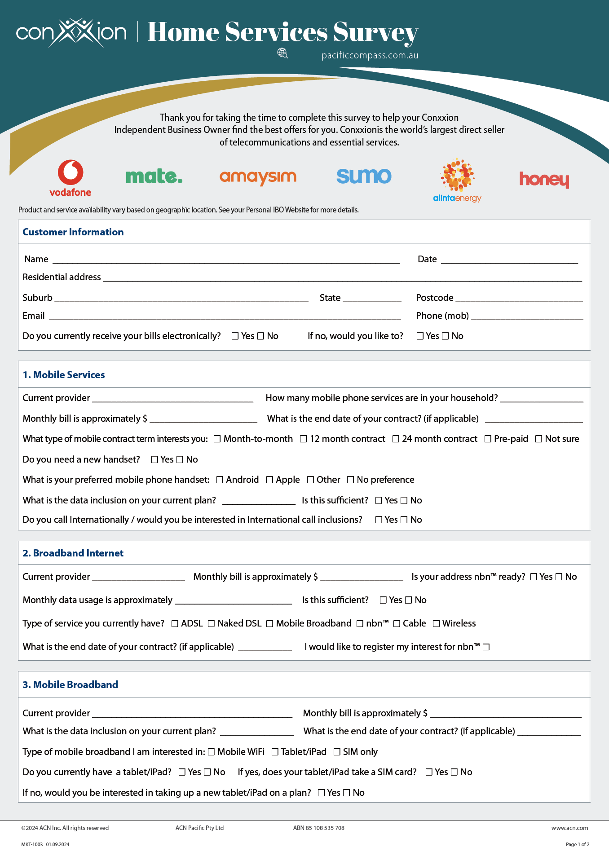
Customer Survey
Customer information
Service information
Contract information
Diarise your appointments

Slide 54
Customer Script
1
2
3
11111
FAVOUR
HELP
TRY
Hi ___________ do you have a minute?
Great, the reason I’m calling you is to ask you for a huge favour and I was wondering if you could help me out?
I’ve just started a part time business from home, helping people save money on their monthly bills.
(Share your reason why)
If I could match or save you money on your Telecommunications, Energy & Essential Services would you give me the opportunity to try? This would really mean a lot to me?
Enthusiasm & Urgency = SUCCESS!

Slide 55

TEAM BUILDING

Slide 56
Team Building
Reminder
We SORT NOT SELL!
YES
MAYBE
NO
20% of your time
0% of your time
80% of your time
20% of your time
0% of your time
Your contact's response is all about timing!

Slide 57

Team Building
Start with your Contact List
YOUR Warm Market (People you know)
PEOPLE CLOSEST TO YOU
Friends
Family
Social Media
Work Associates
Place of Worship
School
Places Where you do Business
Sports/Clubs/Associations
Business Owners

Slide 58



Team Building – 3 steps
How to Build Your Team
3 Steps to Successful Recruiting
1
2
3
Pique Interest
& Invite
SORT
Conxxion Opportunity Presentation
SORT
CORE Basic
Training
SORT

Slide 59
Team Building – 3 steps
How to Build Your Team
Know your Role
1
2
3
Pique Interest & INVITE
YOU
Conxxion Opportunity Presentation
EXPERT
CORE Basic
Training
EXPERT

Slide 60
Team Building – Using an Expert Presenter
The Importance of using an Expert Presenter
Trust & Rapport
YOU
PROSPECT
Introduce
Promote the Presenter
Respect
Effective Presentation
EXPERT
Presenter

Slide 61

Team Building – Types of Conxxion Opportunity Presentations
In-person Private Presentations
Virtual Private Presentations
In-person TEAM Presentations
Virtual TEAM Presentations
PBR Private Business Reception
PBZ Private Business
BOM Business Opportunity Meeting
BOM Business Opportunity
1
2
3
Pique Interest & INVITE
YOU
Conxxion Opportunity Presentation
EXPERT
CORE Basic
Training
EXPERT

Slide 62

Team Building – Schedule your First Presentation & Start Inviting
Host your First Presentation
#1 Get with your EXPERT & Schedule your 1st Presentation
Date / Time. : _____________________________
#2 Start Inviting:

Slide 63
Team Building – INVITING
Effective WORDS when INVITING:
You
Look
up to
Show Respect
Favour
Opinion
Respect
YOU
Your
Peers
Show Respect
Look
up to
You
Simple & Easy

Slide 64


Team Building – Tips & Expectations
Inviting
Tips & Expectations
Excitement & Urgency (Enthusiasm is Contagious)
Follow the “WORDS that WORK” (BE YOURSELF)
FOCUS on INVITING not EXPLAINING (Creates CURIOUSITY)
If you get Questions: (Promote the PRESENTER not the Business)
Typically, Approx 50% Show-up (This is Normal)
HAVE FUN

Slide 65

Team Building – Words That Work
"Piquing Interest" Examples
Do you look at other ways of making money?
Are you open to looking at something outside of what you are currently doing?
Are you open to diversifying your income?
Yes
Maybe
No
Yes
Maybe
No
Yes
Maybe
No
Invite Green & Red Apple Responses

Slide 66
Team Building – Words That Work
“Opinion Approach”
“Great I would love to get your OPINION on something…”
Yes
Maybe
No
Invite Green & Red Apple Responses

Slide 67
Team Building – Words That Work
Inviting: Words That Work
Hello_____, this is_____ do you have a quick minute?
Let me ask you something… Do you look at other ways of making money?
(Share your “WHY”) So I’m always open to other opportunities & I came across something
I met an individual that is having great success in it & I got (Him/Her) to do a quick
zoom Meeting (Day/Time) to show me & a few key people exactly what they’re doing & I would love to get your opinion on it
Can I count you in on joining the Zoom with me & checking it out?

Slide 68
Team Building – Words That Work
Inviting: Words That Work
ANSWER: YES
Great you may receive a call or text from me or someone the day of the zoom Meeting as a "Friendly Reminder".
ANSWER: QUESTIONS
That's a GREAT Question. I don't have all the details yet & that's exactly why we are doing the zoom. As I mentioned, (Expert's Name) is having great success & (He/She) will explain it and get all our questions answered.
I would really love for you to check it out with me and hear what (He/She) has to say. Can I count you in on Joining the zoom?

Slide 69
Team Building – Words That Work
If They Continue Asking Questions?
It's OK to Be New and say,
"That's a GREAT Question…Again that is exactly what the Zoom is for...”
All I know is that it deals with
  ESSENTIAL SERVICES
  NEW TECHNOLOGY
  The TIMING is PERFECT
  NO ONE ELSE is doing it
  It's a HUGE OPPORTUNITY!!
I would love to get your opinion; can I count you in on joining the Zoom?
If available, you can ALSO do a 3-Way Call with your expert.

Slide 70
Team Building – After Presentation
Sorting After Presentation
ARE YOU READY TO GET STARTED?
YES
QUESTIONS
NO
Sign up as an IBO
That's a GREAT Question!
Thank them!
Promote CORE Training!
Promote CORE Training!
Ask them to be a CUSTOMER!

Slide 71
Get your prospects involved in training
Your success depends on it!
Team Building – After Presentation
After the Presentation
How to answer most questions:
That's a great question, idea, etc…
All of that will be covered in the training.

Slide 72

Team Building – Meeting Etiquette
Meeting Etiquette
Make sure you & your guests are on time
Avoid distractions, dress presentable
Host welcome the guests as they come on
Right before presentation begins…
Host ask guests: silence cell phone and hold all questions until the end
Host introduce the speaker and be upbeat and positive the entire time
Participate & support the presenter
ZOOM Etiquette
Mute yourself
Turn on your Camera
Be aware you're on Camera
No Eating
Raise Hand to Speak
Be Respectful
KEEP IT PROFESSIONAL & HAVE FUN

Slide 73
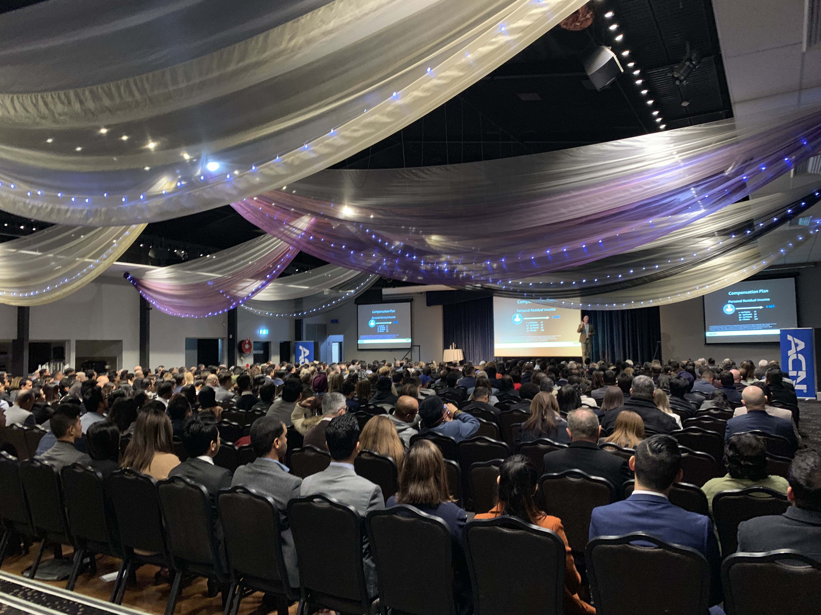
PROMOTING TRAINING EVENTS

Slide 74


Promoting Events
What are Events?
Personal & Team Presentations & Trainings
Leadership Trainings
Customer Acquisition & Product Trainings
COMPANY TRAINING EVENTS

Slide 75
Why Promote Events?
Promoting Events – Value in Events
VISION & BELIEF
Events help you build your team
more effectively than working alone!

Slide 76

Promoting Events
How to Promote:
Training Event highlight videos
Promote the Speakers / Trainers
Testimonials (tell stories, value)

Slide 77



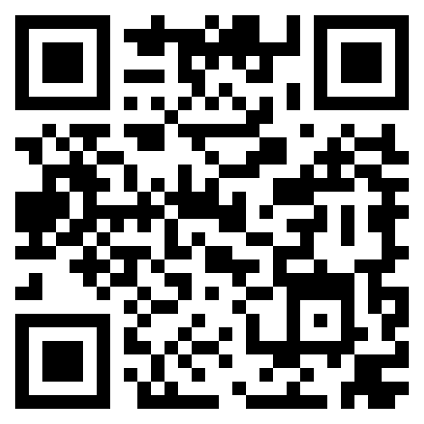
REGISTER NOW
Standard Pricing: $189
Pre-Reg Special
$139
PROMO CODE: PREREG

Slide 78


At Conxxion, you're in business for yourself, never by yourself.

