Slide 1
Home Meetings
SVP Karen Rostagno

Slide 2
ACN is a customer acquisition based company, compensation is only earned when customers are acquired. Success as an ACN Independent Business Owner (IBO) is not guaranteed but is directly influenced by an individuals specific efforts. IBOs are not obliged or required to purchase products or services offered by or through ACN.

Slide 3
Build your list
Write a list of 100 names & numbers
Your list will become your point of reference for piquing
Do not pre-judge!

Slide 4
Who are your 3 hottest prospects?
These are people that you love, look up to, or the most successful people you know.
1)___________
2)___________
3)___________
We want to show ACN to these people immediately!

Slide 5
Home Meetings
Schedule your first 2 home meetings your first week in the business
GOAL: Show 10 – 20 people the information in your first 7 days
Grand Opening
First home meeting should be in the next 72 hours

Slide 6
How to invite to your home meeting
You invite while the leader is with you
When you invite, just be yourself with a sense of excitement, urgency and conviction.
The leader presents for you.

Slide 7
How to invite to your home meeting
Close friends & family
“Hi ____, its ___. How are you? I’m so excited… do you have a second to talk?”
“What are you doing on ____ (day), at ____(time)?”
(Option 1) “Are you interested in making money?”
(Option 2) “Do you keep your business options open?”

Slide 8
How to invite to your home meeting
If they say yes…
Give time, date and address
If they ask questions…
Example: “What’s it about?” (Option 1) “Look, I wouldn’t be able to do it justice over the phone, that’s why we need to get together so you can see it exactly like I did.”
-OR- (Option 2) “It’s about the communications & energy markets and how we can get paid on it!”
The Goal is to get the prospect in front of the leader for the presentation

Slide 9
How to invite to your home meeting
If they want more information:
“I’d really like to give you more information, but I’m brand new; however, I am sitting here with an expert who can. I’d like to introduce you to Mr/Mrs/Miss __________.”
Then pass the phone to the leader.
The leader will explain the business in about 3 minutes and book an appointment or invite your prospect to your home meeting.

Slide 10
The magic edification triangle
The prospect trusts you.
You edify the expert to the prospect.
Now the prospect respects the expert.
Trust + Respect = Success
EXPERT
Respect
PROSPECT
Edify
Trust
YOU

Slide 11
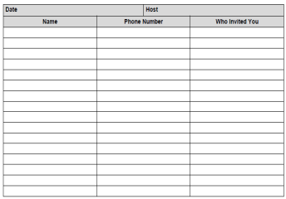
Room & Material Checklist Before your meeting
Give presenter guest list to confirm your guests
All phones turned off & Room temp cool
Kids in bed/babysitter/Pets outside
Refreshments (No Alcohol) Simple snacks
Upbeat music before and after meeting
Prepare for your meeting.
Sign-in Sheet.

Slide 12
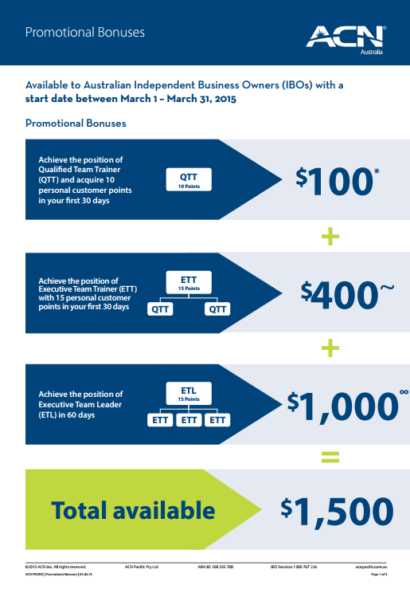
Room & Material Checklist Before your meeting
ACN Overview
QuickStart Bonuses
Flyer

Slide 13
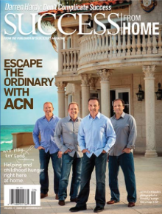
Room & Material Checklist After your meeting
Turn music on immediately after your meeting is over
Break the room and ask all guests:
“What did you like best about what you heard?”
Demonstrate your ACN online store
Every guest gets a DVD and Magazine

Slide 14
Role of the new IBO
Sit through the presentation
Take notes…listen and learn!
Be EXCITED and interested
SORT guests after the presentation - Introduce them to the speaker
PROMOTE weekly training
Reminders:
Do not apologise for no-shows
Do not get up during presentation
Do not interrupt the presenter….EVER!!!

Slide 15
Sorting “What did you like best about what you heard?”
Red 80%
Green 20%
1. Sign-up
2. Launch
3. Training
4. DVD & Magazine
1. Answer Questions
2. Training
3. DVD & Magazine
Thank them
Get as Customer
Get a Referral
Stay in Touch

