Slide 1
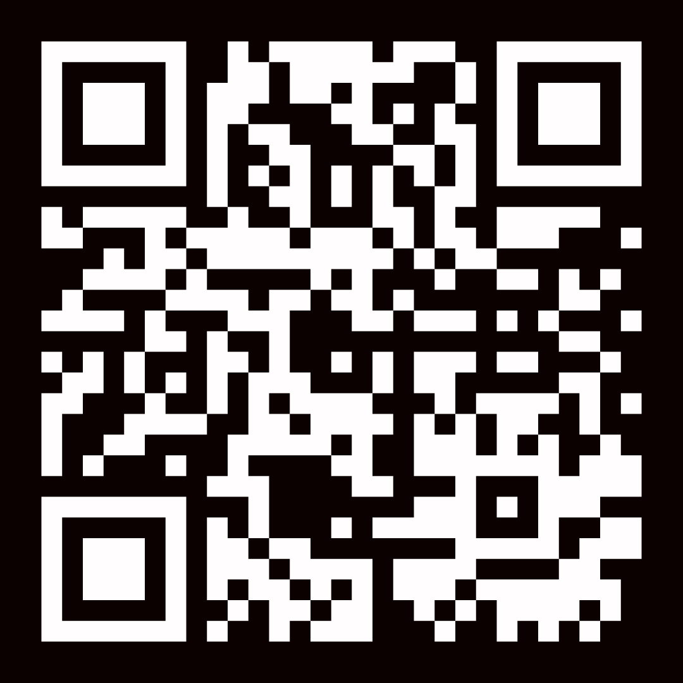
REGISTER NOW
Standard Pricing: $149 PRE REGISTRATION
$129
PROMO CODE: PREREG

